Slide 1

Person Retrieval in Surveillance Video using Height, Color and Gender
Challenge II: Semantic Person Retrieval in Surveillance Using Soft Biometrics
In association with IEEE AVSS 2018, 27th November 2018,
Auckland, New Zealand
Hiren Galiyawala | Kenil Shah | Vandit Gajjar | Mehul S. Raval
Ahmedabad University, India | L. D. College of Engineering, India | Ahmedabad University, India | Ahmedabad University, India

Slide 2
Outline
Introduction
Problem statement
Proposed approach
Experimental setup and results
Conclusions
References

Slide 3
Introduction
Surveillance systems [2] have been deployed to control crime rate.
Retrieve the person(s) using semantic queries e.g., a tall male with a black t-shirt and blue jeans.
A person is commonly described by attributes (soft biometrics) like height, build, cloth color, cloth type, and gender [1, 3].
Extraction from low-quality surveillance video at a distance without cooperation from the subject.
Nixon MS, Correia PL, Nasrollahi K, Moeslund TB, Hadid A, Tistarelli M. On soft biometrics. Pattern Recognition Letters. 2015 Dec 15; 68:218-30.
Reid DA, Samangooei S, Chen C, Nixon MS, Ross A. Soft biometrics for surveillance: an overview. In Handbook of statistics 2013 Jan 1 (Vol. 31, pp. 327-352). Elsevier.
Dantcheva A, Elia P, Ross A. What else does your biometric data reveal? A survey on soft biometrics. IEEE Transactions on Information Forensics and Security. 2016 Mar;11(3):441-67.

Slide 4
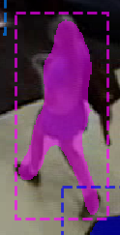
Problems of previous approaches [4 – 9]
The bounding box with cluttered background may impact the person retrieval accuracy for low-resolution video.
Person’s height is estimated based on the bounding box leads to an incorrect height estimation.

Slide 5
Solutions
Use of semantic segmentation (pixel level segmentation)
  It removes unwanted background clutter.
  Better estimate of the real-world height.
  It extracts precise patch for torso color classification.
The height as filter for upright and sitting position of the person.

Slide 6
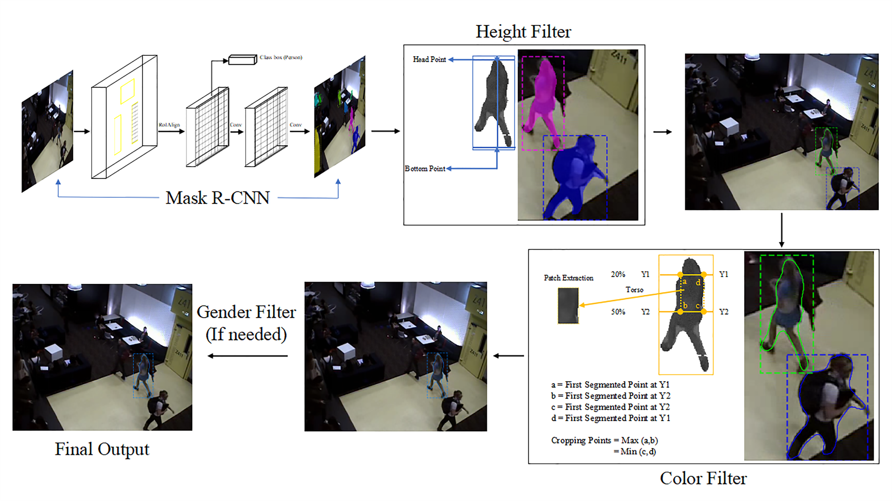
Proposed approach

Slide 7
Experimental setup [10]
AVSS challenge semantic soft biometric search dataset is used.
6 surveillance cameras located within a security network of a Queensland University campus.
Tsai camera calibration parameters.
110 training subjects and 41 testing subjects with varying sequence lengths between 21 and 290 frames.
Persons are annotated with 9 body markers in each frame and 16 soft biometric traits.
Each frame has resolution of 704 x 576.
Halstead M, Denman S, Sridharan S, Fookes CB. Locating people in video from semantic descriptions: A new database and approach. In Proceedings of the 22nd International Conference on Pattern Recognition 2014 (pp. 4501-4506). IEEE.

Slide 8
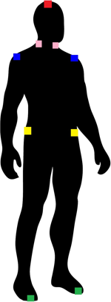
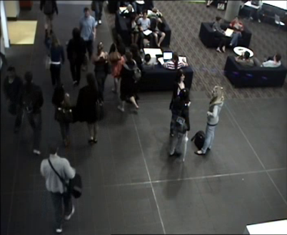
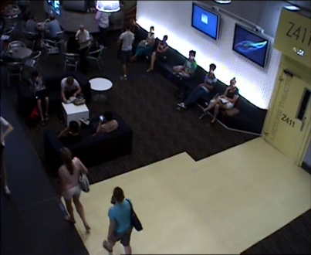
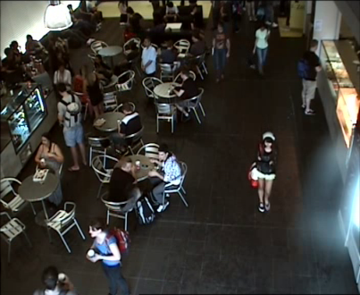
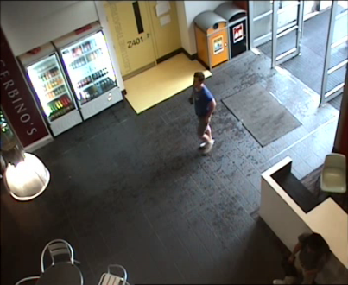
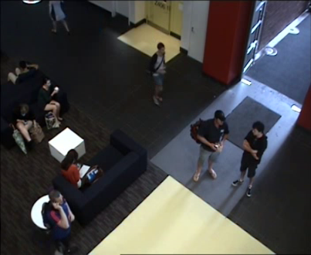
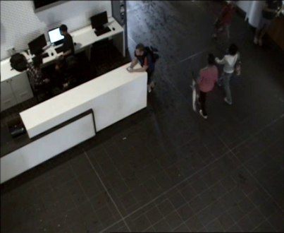
Experimental setup [10]
Halstead M, Denman S, Sridharan S, Fookes CB. Locating people in video from semantic descriptions: A new database and approach. In Proceedings of the 22nd International Conference on Pattern Recognition 2014 (pp. 4501-4506). IEEE.

Slide 9
Implementation details
Detection and semantic segmentation
  Weights of Mask R-CNN [11] pretrained on Microsoft COCO [12].
Data augmentation
  Horizontally and vertically flip
  Rotation with 10 angles {1º, 2º, 3º, 4º, 5º, -1º, -2º, -3º, -4º, -5º}
  Brightness increased with gamma factor of 1.5.
Color and gender models
  fine-tuned using AlexNet [13] pretrained on ImageNet [14] dataset
He K, Gkioxari G, Dollár P, Girshick R. Mask r-cnn. In Computer Vision (ICCV), 2017 IEEE International Conference on 2017 Oct 22 (pp. 2980-2988). IEEE.
Lin TY, Maire M, Belongie S, Hays J, Perona P, Ramanan D, Dollár P, Zitnick CL. Microsoft coco: Common objects in context. In European conference on computer vision 2014 Sep 6 (pp. 740-755). Springer, Cham.
Krizhevsky A, Sutskever I, Hinton GE. Imagenet classification with deep convolutional neural networks. In Advances in neural information processing systems 2012 (pp. 1097-1105).
Deng J, Dong W, Socher R, Li LJ, Li K, Fei-Fei L. Imagenet: A large-scale hierarchical image database. In Computer Vision and Pattern Recognition, 2009. CVPR 2009. IEEE Conference on 2009 Jun 20 (pp. 248-255)..

Slide 10
Implementation details
Color training:
  1704 color patches divided into 12 culture colors.
  Additional patches for color training are extracted using 4 body markers from the training dataset.
  Augmented by increasing brightness with a gamma factor of 1.5.
  Approximately 17000 color patches are generated
  80% for training and 20% for the validation set.
  AlexNet - (Conv5, fc6, fc7, and fc8) are fine-tuned, epochs = 30, learning rate = 0.001, dropout = 0.50, batch size = 128.
  Accuracy of 71.2% on the validation set.

Slide 11
Implementation details
Gender training:
  105980 images with augmentation
  80% for training and 20% for the validation set.
  AlexNet - (fc6, fc7, and fc8) are fine-tuned, epochs = 20, learning rate = 0.0001, dropout = 0.40, batch size = 64.
  Accuracy of 68% on the validation set.

Slide 12
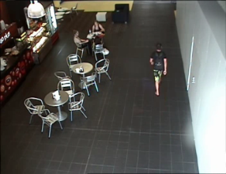
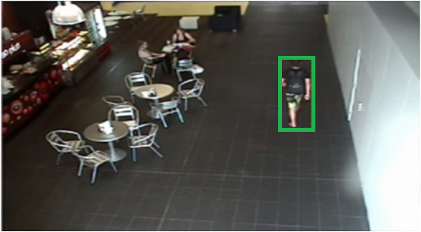
Experimental results – True Positive
Seq.10, F.59: height (170 – 190 cm), torso color (black) and gender (male). Person retrieved using only height.

Slide 13
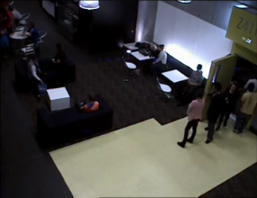
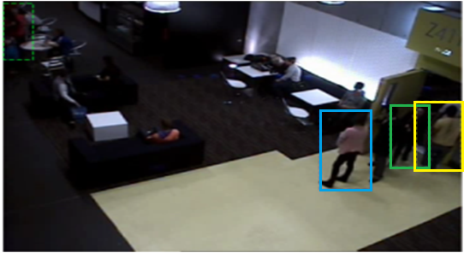
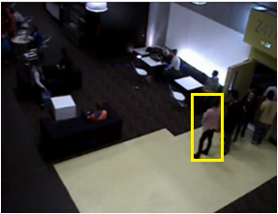
Experimental results – True Positive
Seq.04, F.76: height (160 – 180 cm), torso color (pink) and gender (female). Person retrieved using height and torso color.

Slide 14
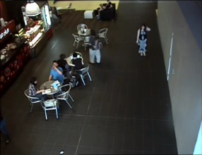
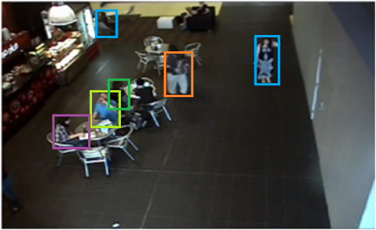
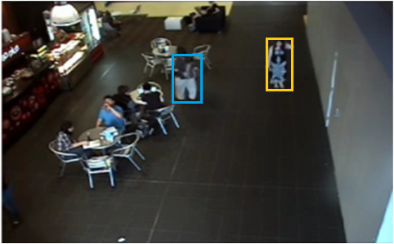
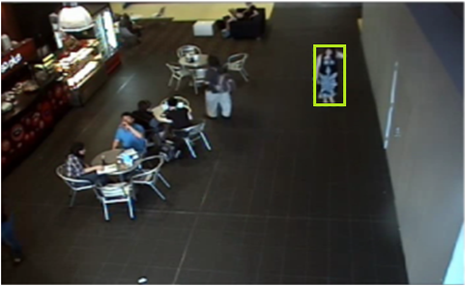
Experimental results – True Positive
Seq.8, F.31: height (130 – 160 cm), torso color (black) and gender (female). Person retrieved using height, torso color and gender.

Slide 15
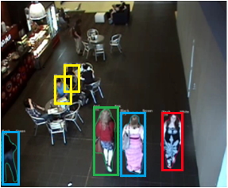
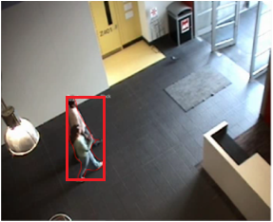
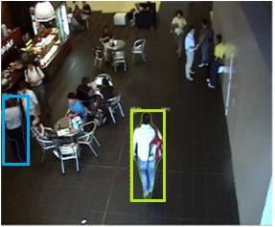
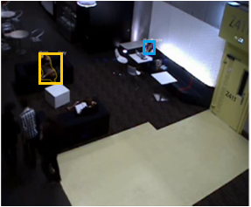
Experimental results – False Negative
(a)
(b)
(c)
(d)
(a) incorrect color classification with multiple persons, (b) multiple persons with occlusion, (c) multiple persons with same torso color and height class and (d) person detection fails.

Slide 16
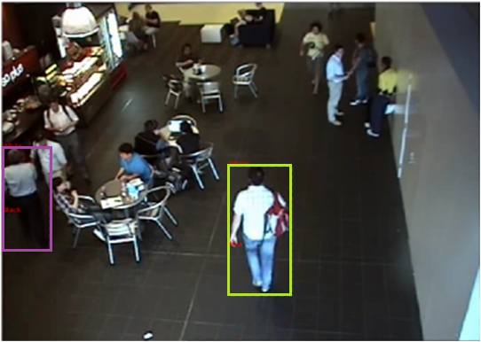
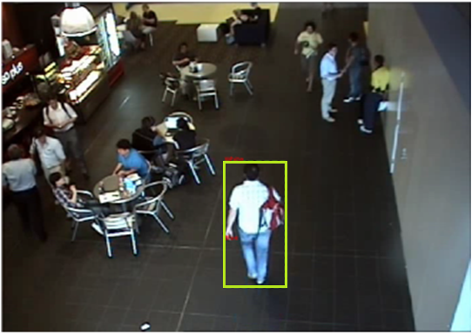
Leg color to improve retrieval
Seq.18, F.31: height (180 – 210 cm), torso color (white) and gender (male)

Slide 17
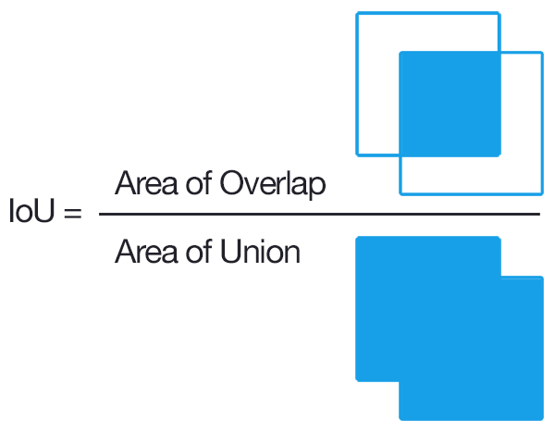
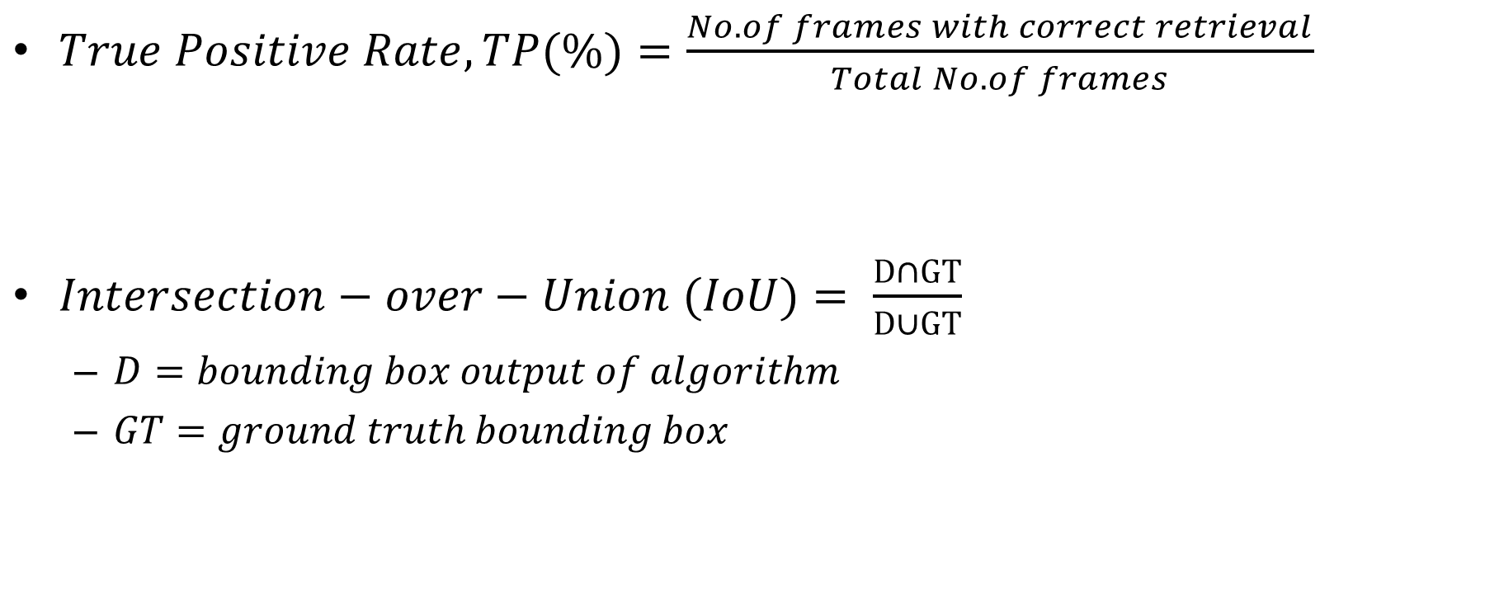
Quantitative results
$True Positive Rate, TP(\%)=\frac{No.of frames with correct retrieval}{Total No.of frames}$
$Intersection−over−Union (IoU)= \frac{D∩GT}{D∪GT}$
  $D=bounding box output of algorithm$
  $GT=ground truth bounding box$

Slide 18
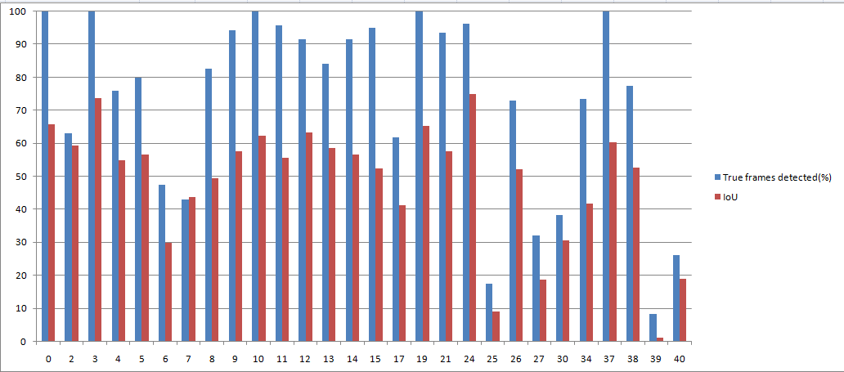
Quantitative results
28 out of 41 persons are correctly retrieved.
Average IoU - 0.3905
56.17% of frames have IoU > 0.4
True Positive rate (%) | No. of person retrieved
> 60% | 20
30% - 60% | 4
< 30% | 4

Slide 19
Conclusion
Use of semantic segmentation allows better height estimation
Precise color patch extraction from the torso
Algorithm correctly retrieves 28 persons out of 41 using soft biometric attributes.
The algorithm achieves an average IoU of 0.3905
IoU of greater than or equal to 0.4 for 56.17% of frames.

Slide 20
Acknowledgement
The authors would like to thank Board of Research in Nuclear Sciences (BRNS) for generous grant (36(3)/14/20/2016-BRNS/36020) to carry out this research work.
We would also like to thank the SAIVT Research Labs at Queensland University of Technology (QUT) for freely supplying us with the SAIVT-SoftBioSearch database for our research.
We acknowledge the support of NVIDIA Corporation for a donation of the Quadro K5200 GPU used for this research.

Slide 21
References
Nixon MS, Correia PL, Nasrollahi K, Moeslund TB, Hadid A, Tistarelli M. On soft biometrics. Pattern Recognition Letters. 2015 Dec 15; 68:218-30.
Reid DA, Samangooei S, Chen C, Nixon MS, Ross A. Soft biometrics for surveillance: an overview. In Handbook of statistics 2013 Jan 1 (Vol. 31, pp. 327-352). Elsevier.
Dantcheva A, Elia P, Ross A. What else does your biometric data reveal? A survey on soft biometrics. IEEE Transactions on Information Forensics and Security. 2016 Mar;11(3):441-67.
Denman S, Halstead M, Bialkowski A, Fookes CB, Sridharan S. Can you describe him for me? a technique for semantic person search in video. Proceedings of Digital Image Computing: Techniques and Applications 2012. 2012:1-8.
Halstead M, Denman S, Sridharan S, Fookes CB. Locating people in video from semantic descriptions: A new database and approach. In Proceedings of the 22nd International Conference on Pattern Recognition 2014 (pp. 4501-4506). IEEE.
Denman S, Halstead M, Fookes C, Sridharan S. Searching for people using semantic soft biometric descriptions. Pattern Recognition Letters. 2015 Dec 15;68:306-15.
Zhu J, Liao S, Yi D, Lei Z, Li SZ. Multi-label cnn based pedestrian attribute learning for soft biometrics. In Biometrics (ICB), 2015 International Conference on 2015 May 19 (pp. 535-540). IEEE.
Sudowe P, Spitzer H, Leibe B. Person attribute recognition with a jointly-trained holistic cnn model. In Proceedings of the IEEE International Conference on Computer Vision Workshops 2015 (pp. 87-95).
Li D, Chen X, Huang K. Multi-attribute learning for pedestrian attribute recognition in surveillance scenarios. In Pattern Recognition (ACPR), 2015 3rd IAPR Asian Conference on 2015 Nov 3 (pp. 111-115). IEEE.

Slide 22
References
Halstead M, Denman S, Sridharan S, Fookes CB. Locating people in video from semantic descriptions: A new database and approach. InProceedings of the 22nd International Conference on Pattern Recognition 2014 (pp. 4501-4506). IEEE.
He K, Gkioxari G, Dollár P, Girshick R. Mask r-cnn. In Computer Vision (ICCV), 2017 IEEE International Conference on 2017 Oct 22 (pp. 2980-2988). IEEE.
Lin TY, Maire M, Belongie S, Hays J, Perona P, Ramanan D, Dollár P, Zitnick CL. Microsoft coco: Common objects in context. In European conference on computer vision 2014 Sep 6 (pp. 740-755). Springer, Cham.
Krizhevsky A, Sutskever I, Hinton GE. Imagenet classification with deep convolutional neural networks. In Advances in neural information processing systems 2012 (pp. 1097-1105).
Deng J, Dong W, Socher R, Li LJ, Li K, Fei-Fei L. Imagenet: A large-scale hierarchical image database. In Computer Vision and Pattern Recognition, 2009. CVPR 2009. IEEE Conference on 2009 Jun 20 (pp. 248-255)..
Shah P, Raval MS, Pandya S, Chaudhary S, Laddha A, Galiyawala H. Description Based Person Identification: Use of Clothes Color and Type. InComputer Vision, Pattern Recognition, Image Processing, and Graphics: 6th National Conference, NCVPRIPG 2017, Mandi, India, December 16-19, 2017, Revised Selected Papers 6 2018 (pp. 457-469). Springer Singapore.
Raval MS, “Digital Video Forensics: Description Based Person Identification”, CSI Communications, Vol. 39, No. 12, pp. 9 - 11, March 2016.

Slide 23
Thank You

